Slide 1
Twenty-First-Century Statistical and Computational Challenges in Astrophysics (1)
Tao Jing
2023.05.09

Slide 2
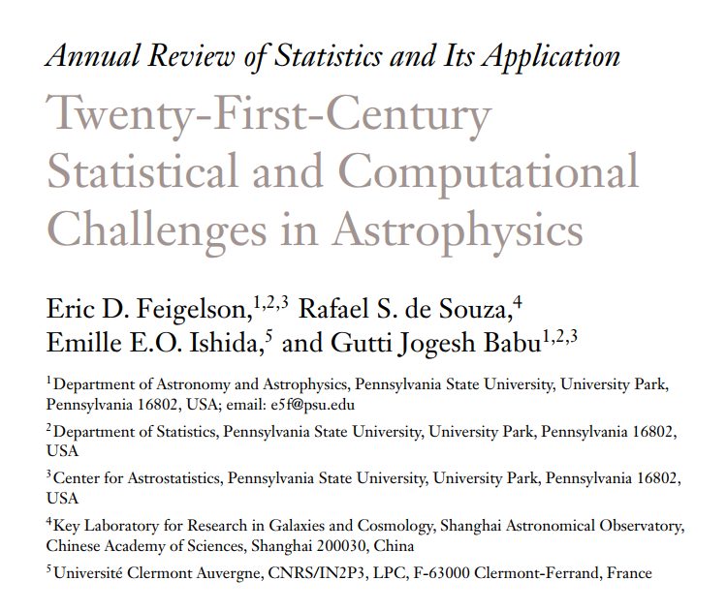

Slide 3
Structures finder

Slide 4
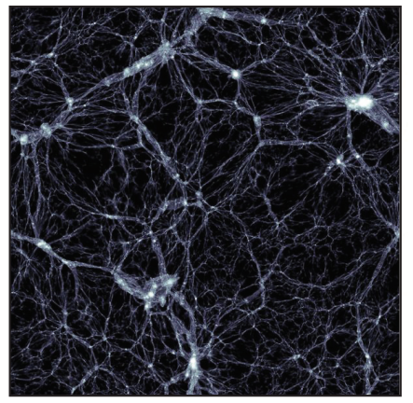
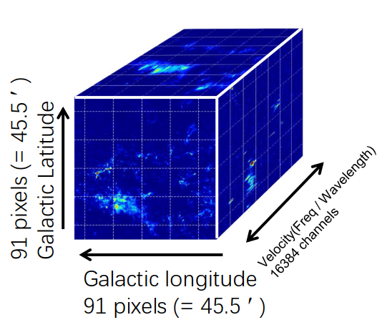
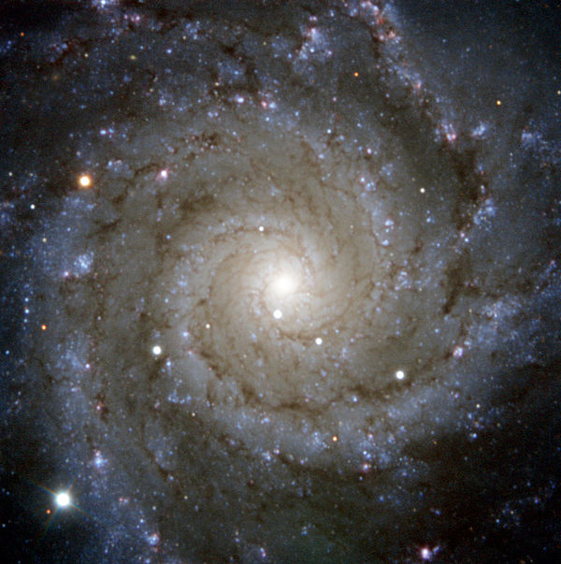
Structures finder
Find filament in Dark Matter field
Find Molecular cloud in 3d datacube
Find Spiral arm in galaxy image
Qingzeng Yan’s talk about 银河画卷
From wiki

Slide 5
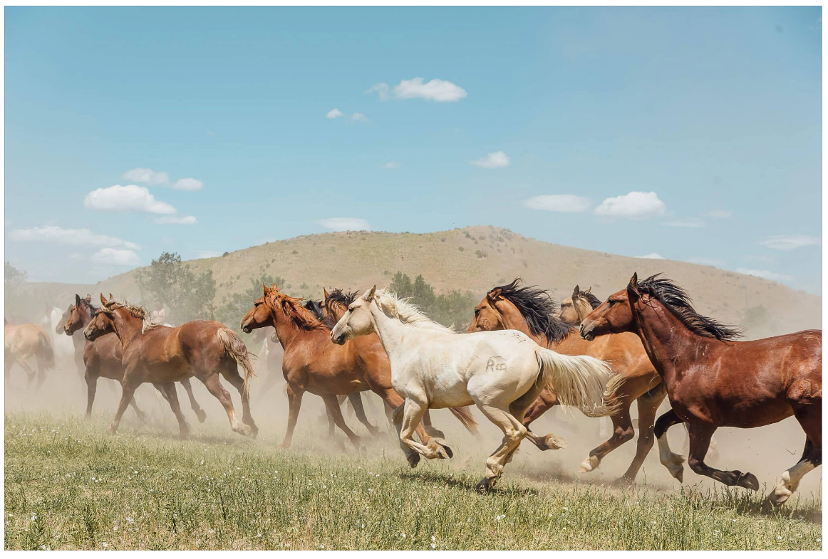
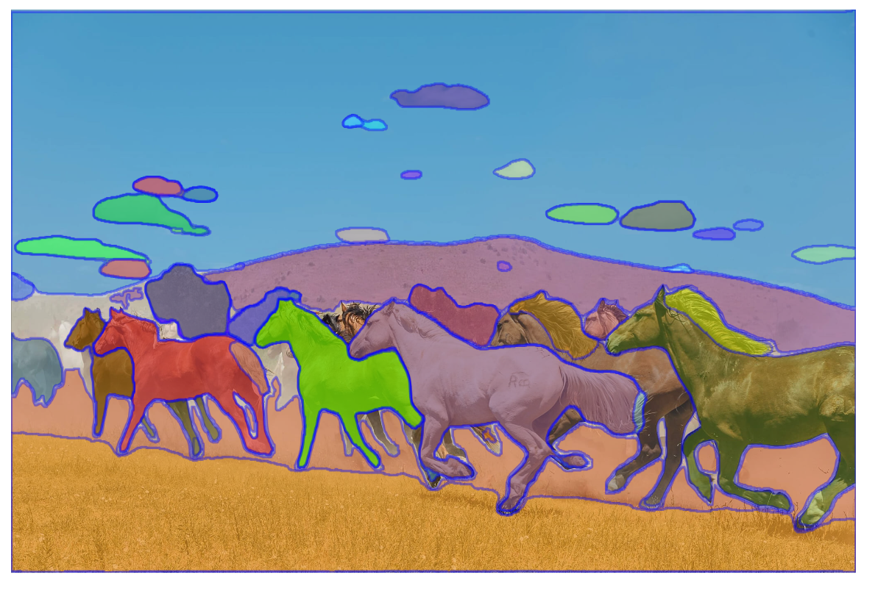
Structures finder
Machine learning is a way to go, but we will suffer from the lack of labeled data.
Segment Anything Model (SAM) or SegGPT like model is all we need?
https://segment-anything.com/demo#

Slide 6

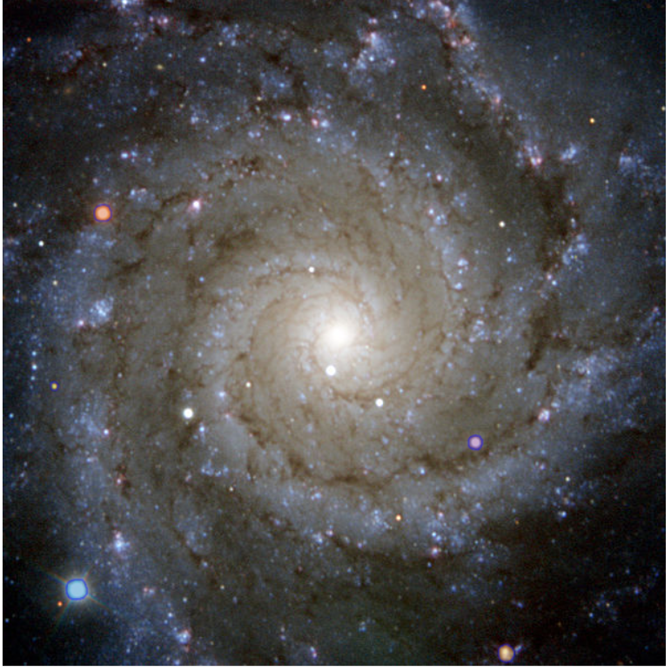

Structures finder
Segment Anything Model (SAM) doesn’t work so good in Astro-image
We need to train such model in Astro-data.
But we don’t have so many high quality data.
Low-Rank Adaptation (LoRA) is all you need

Slide 7

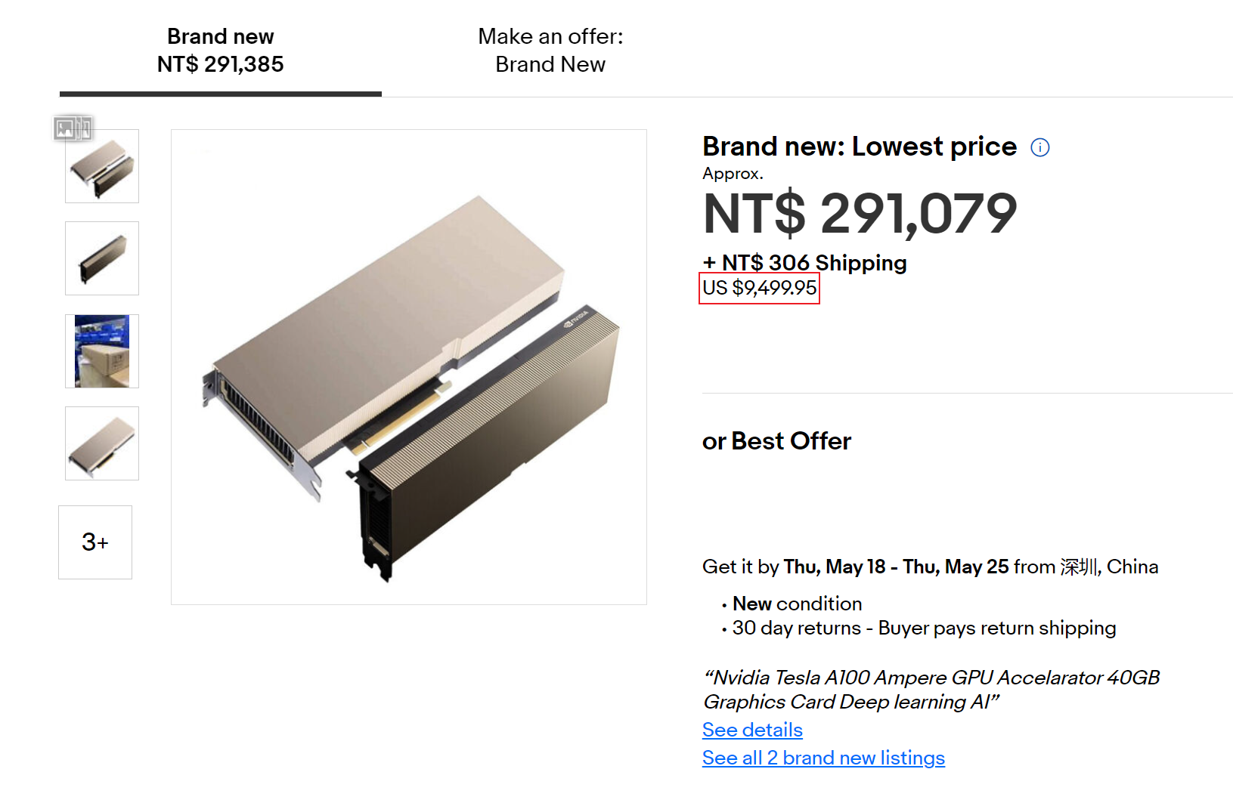
Low-Rank Adaptation (LoRA)
I will not describe the detail of LoRA. You can just take it as a magic to tune very large model (typically use about 1e4 GPUs in training) in your laptop.
No LoRA, no cyber coser
https://www.pixiv.net/en/artworks/106236282

Slide 8
Subsection summary
Problem: structure finder, but not your eyes
Possible solution: large model (e.g. SAM) + finetune method (e.g. LoRA)
“More is different”, how about large?

Slide 9
Compare point set

Slide 10
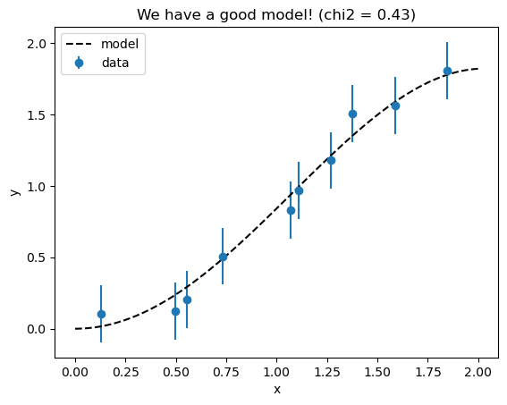
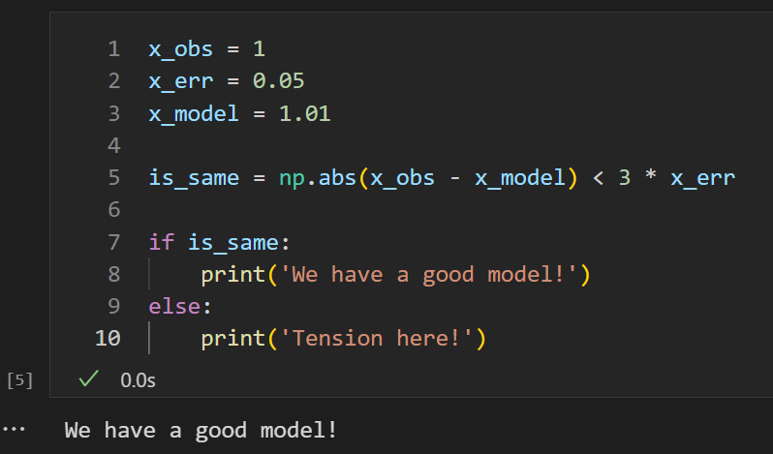
Let’s compare ...
Value:
Curve:

Slide 11
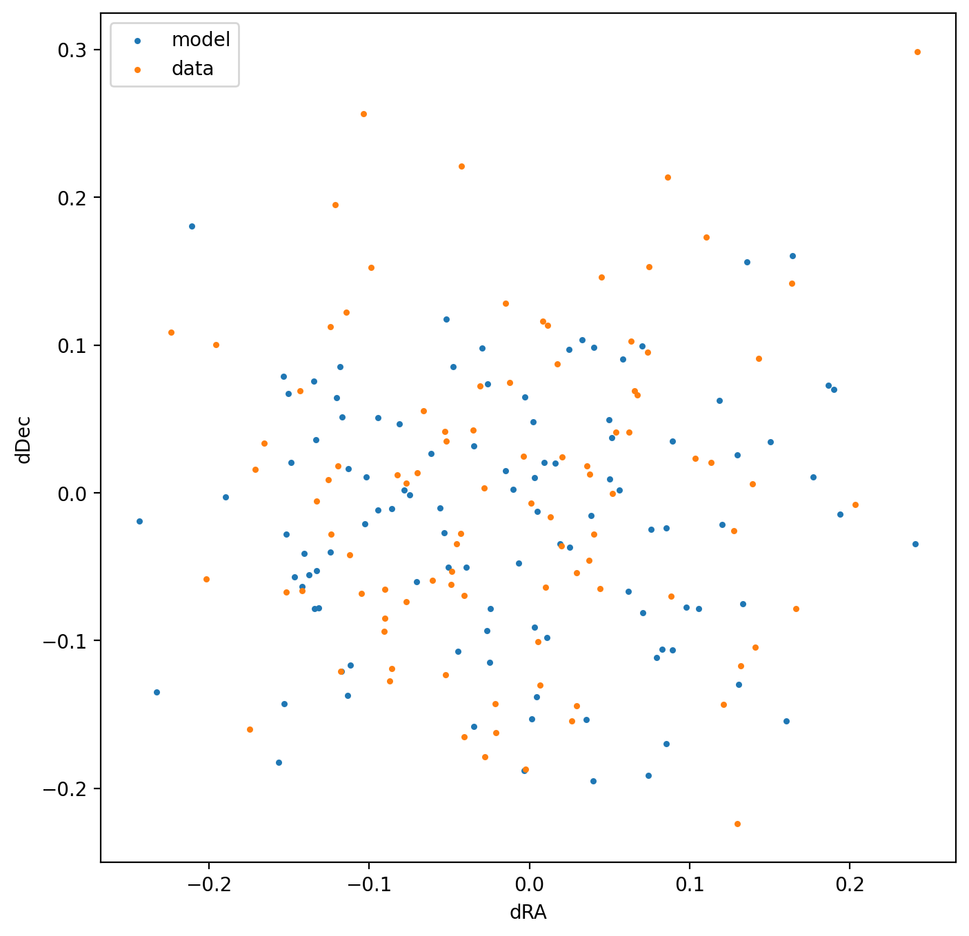
Let’s compare ...
Point set

Slide 12
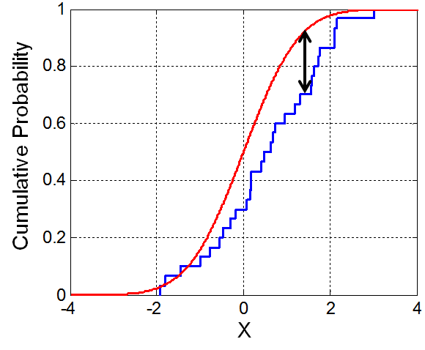
In 1d case, we have KS test
From wiki

Slide 13
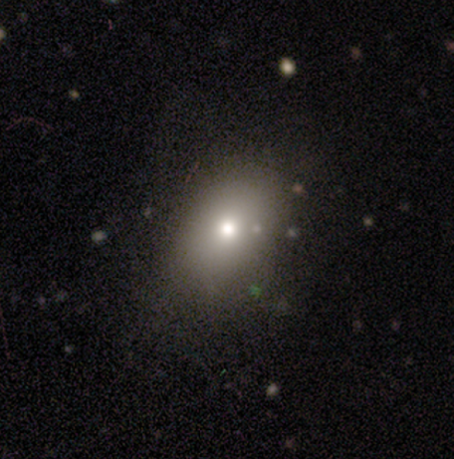
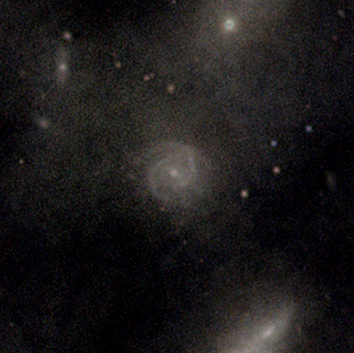
How about 2d?
Maybe we can calculate 2 point correlation function (2-pcf) and then compare 2-pcf?
If the data don’t come from Gaussian random field, the same 2-pcf don’t mean same distribution. （Show it by Power Spectrum (PS) of image)
These two image have identical PS

Slide 14
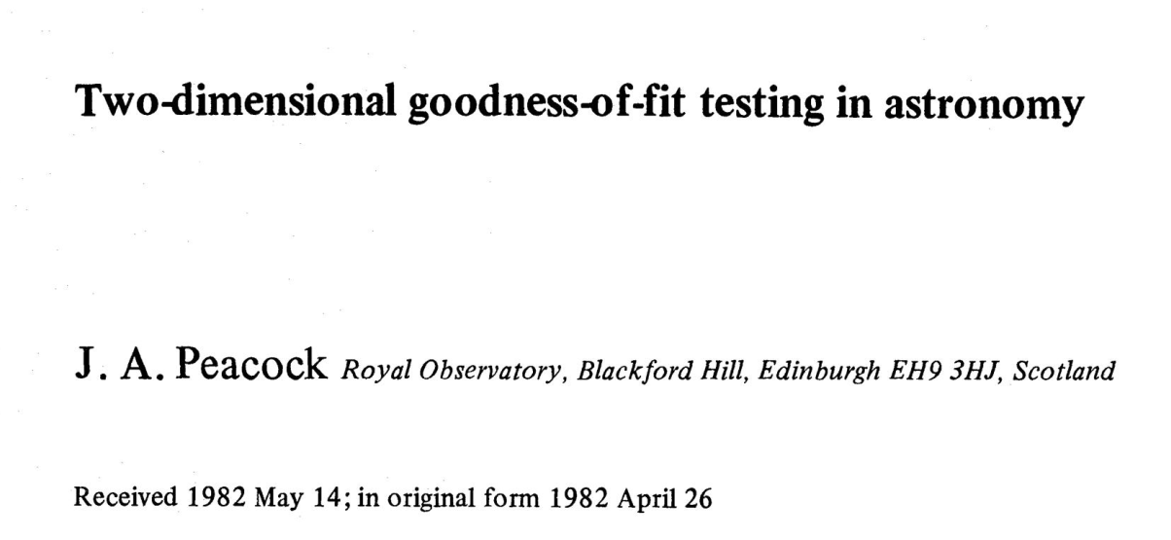
How about 2d?
Good News: We have nd KS test

Slide 15
How about 2d?
Good News: We have nd KS test
Bad News: Time complexity: $o(2^{d}N^{2})$

Slide 16
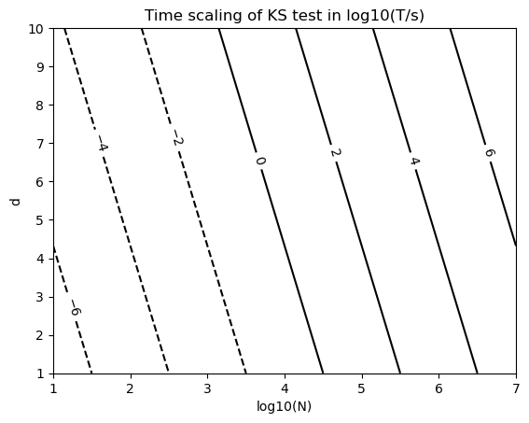
It's just a matter of time
For a highly optimized code, when d=2, N=10000, t ~ 0.2s

Slide 17
But there is no analytical solution for p-value, only an approximation.
The approximation is good enough in most of cases in 2d, or you can use Bootstrapping to get a more accurate p-value.

Slide 18
Subsection summary
Problem: compare two point sets, beyond 2-pcf
Possible solution: nd ks test

Slide 19
How to digest the achievements of other disciplines?

Slide 20

How to digest the achievements of other disciplines?

Slide 21
一个刻舟求剑的例子
Target: morphology classification in a new survey (say use Beyond Earth Super Telescope (BEST), a moon base 100m telescope).
Challenge: no labelled data.
Proposed solution: use the labelled data in old survey such as SDSS. Then use Domain Adaptation technical.

Slide 22
一个刻舟求剑的例子
Feature
Morphology Classifier
Disk
Elliptical
…
SDSS image
Feature extractor
BEST image
Survey Classifier
SDSS
BEST

Slide 23
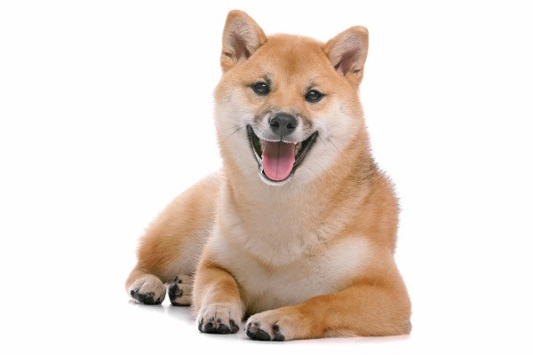
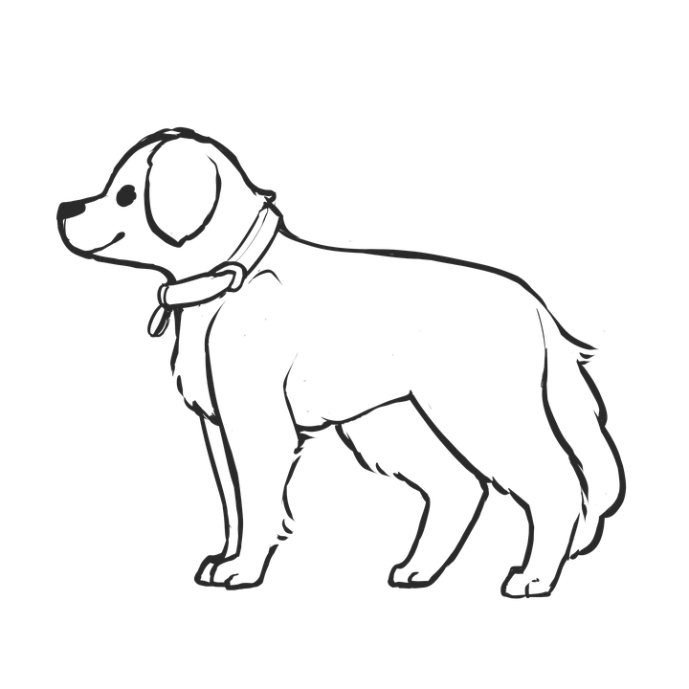
This technical really works when...
Feature
Animal Classifier
Cat
Dog
…
Feature extractor
Style Classifier
Photograph
Sketch
https://health.ettoday.net/news/846906
https://pixabay.com/zh/illustrations/dog-puppy-outline-pet-animal-5759699/

Slide 24
This technical can not work when...
Feature
Animal Classifier
White Cat
Yellow Dog
…
Feature extractor
Style Classifier
Gray
RGB
https://health.ettoday.net/news/846906

Slide 25
Feature
Morphology Classifier
SDSS image
Feature extractor
BEST image
Survey Classifier
This method just take BEST image as SDSS image, so we can not have anything new, just waste the high data quality of BEST.

Slide 26
Subsection summary
Problem:
鸟何萃兮蘋中，罾何为兮木上？

Slide 27
Take home message
Structures finder, fine tune large model
Compare point sets, nd KS test

Slide 28
More topics
Irregular Time Series
Generative stochastic processes behind the distribution
Are MLE or MPE all we need?
Efficient Bayesian Inference
How to deal with complex uncertainty behaviors
…

Slide 29
Thanks

